Slide 1

Minimum Spanning Trees
Presented by
Sneha Agrawal
MET CS 566 - Analysis of Algorithms
Notes:
Good day, I am Sneha Agrawal presenting a project on minimum spanning tree. I choose this topic because I have reading about greedy algorithms and wanted to dive deep into such algorithms. I hope the presentation gives you clear idea on the funtioning of MST.

Slide 2
INTRODUCTION
A Minimum Spanning Tree (MST) is a subset of the edges of a connected, weighted, undirected graph that connects all vertices with the minimum possible total edge weight.
MSTs have various applications in network design, clustering, and approximation algorithms.
This presentation will cover the basics of graph theory, the MST problem, and two popular algorithms for finding MSTs: Kruskal's and Prim's algorithms.
Notes:
Let's talk about what is MST, it is a subgraph 'T' of a graph 'G(V,E) where V is the vertices and E is the edges that connect vertices to each other. MST must connected meaning you must be able to reach all vertices. Various applications of MST are in .....

Slide 3
GRAPH THEORY BASICS
A graph G = (V, E) consists of a set of vertices V and a set of edges E connecting the vertices.
Graphs can be directed (edges have a specific direction) or undirected (edges have no direction).
In a weighted graph, each edge has an associated weight or cost.
Notes:
As stated spanning tree is a subgraph of a graph G which consists of vertices and edges. Note that a graph can be directed/not directed meaning either edges have direction or not. In a weighted graph, each edge has an associated weight or cost. Through this we can estimated MIN ST.

Slide 4
PROBLEM STATEMENT
Given a connected, weighted, undirected graph G = (V, E), find a spanning tree T = (V, E') such that E' ⊆ E and the total weight of the edges in T is minimized.
Input: Connected, weighted, undirected graph G = (V, E)
Output: Minimum Spanning Tree T = (V, E') with minimum total edge weight
Notes:
While G= (V,E). It's subgraph T= (V',E'). V = V' (SAME VERTICES FOR BOTH) while E' < E (AS E' = V-1) Thus, we input.... We get a MST "T" = ........

Slide 5
PROPERTIES OF MST
A spanning tree is a subgraph that includes all vertices of the original graph and has no cycles.
If all edge weights in a graph are distinct, the MST is unique.
Cut property: For any cut in the graph, the minimum weight edge crossing the cut must be part of the MST.
Cycle property: For any cycle in the graph, the maximum weight edge in the cycle must not be part of the MST.
Notes:
Talking about the properties, A ST is a subtree that incldes all vertices of original graph and v-1 edges. must be connected meaning able to reach all vetices There shall be no cycle as it will violate connected property if a graph is complete, then the number of possible st is n^n-2 A graph can have more than 1 mst.

Slide 6
KRUSKAL’S ALGORITHM
Sort all edges in non-decreasing order of their weights.
Initialize an empty set T to store the MST edges.
Iterate through the sorted edges:
If adding the current edge to T does not create a cycle, include it in T.
Otherwise, discard the current edge.
Return T as the Minimum Spanning Tree.
Notes:
Now, there are 2 most important MST. Let's first dive into kruskal's algo These are the steps to follow:

Slide 7

EXAMPLE
Notes:
Let understand it through an example: Here Q is original graph and C is the empty list we are initialising. We start from vertice s ..........

Slide 8


Slide 9

Running time = O((n + m) log n)
Total weight = 20

Slide 10
PRIM’S ALGORITHM
Initialize an empty set T to store the MST edges and a set V' to store visited vertices.
Choose an arbitrary starting vertex s and add it to V’.
While V' ≠ V:
Find the minimum weight edge (u, v) such that u ∈ V' and v ∉ V'.
Add (u, v) to T and v to V’.
Return T as the Minimum Spanning Tree.
Notes:
Another is Prim's algorithm.

Slide 11

EXAMPLE
– Red: min-weight edge;
– Yellow: in the cloud
– Blue: cloud and Q boundary

Slide 12
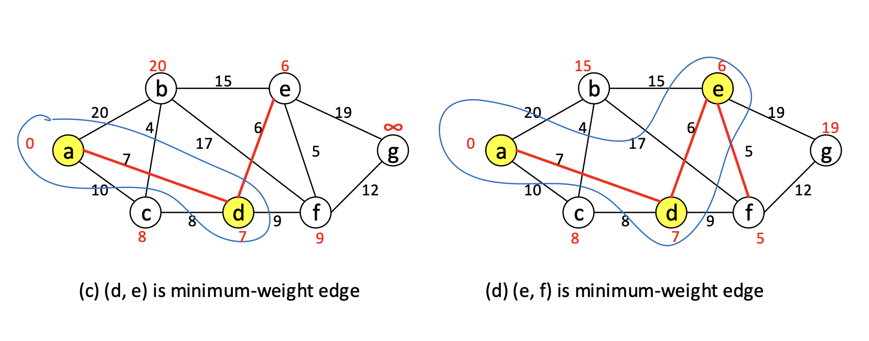

Slide 13
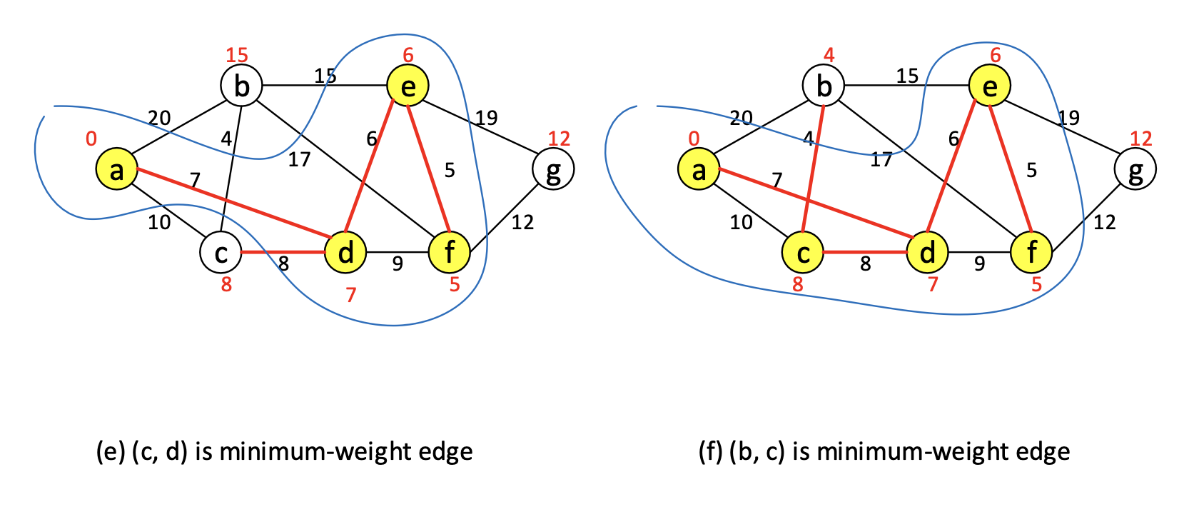

Slide 14
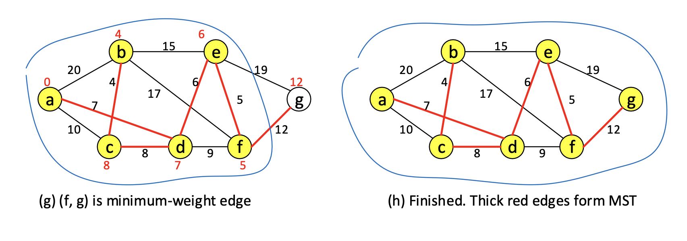
Running time = O((n + m) log n) Total weight = 42

Slide 15
COMPARISION
Kruskal's algorithm: O(E log E) or O(E log V) time complexity using a disjoint-set data structure.
Prim's algorithm: O(E log V) time complexity using a binary heap, or O(V^2) using an adjacency matrix.
Kruskal's algorithm is better for sparse graphs, while Prim's algorithm is better for dense graphs.
Both algorithms guarantee to find the MST of a connected, weighted, undirected graph.

Slide 16
APPLICATIONS OF MST
Designing efficient communication networks, such as telephone or computer networks.
Finding the shortest path for transportation networks, like roads or railways.
Clustering data points in machine learning and data mining.
Image segmentation in computer vision.
Constructing approximate solutions for NP-hard problems, such as the Traveling Salesman Problem.

Slide 17
CONCLUSION
Minimum Spanning Trees are fundamental structures in graph theory with numerous real-world applications.
Kruskal's and Prim's algorithms are efficient methods for finding MSTs in connected, weighted, undirected graphs.
Understanding MSTs and their algorithms is crucial for designing efficient networks and solving optimization problems.
Future research can focus on extending MST algorithms to handle more complex graph types or developing faster parallel implementations.

Slide 18
REFERENCES
Cormen, T. H., Leiserson, C. E., Rivest, R. L., & Stein, C. (2009). Introduction to Algorithms, 3rd Edition. MIT Press.
Prim, R. C. (1957). Shortest connection networks and some generalizations. Bell System Technical Journal, 36(6), 1389-1401.
Kruskal, J. B. (1956). On the shortest spanning subtree of a graph and the traveling salesman problem. Proceedings of the American Mathematical Society, 7(1), 48-50.
Course material.

Slide 19
THANK YOU

